Slide 1

INTRODUCTION TO SQL SERVER

Slide 2


Slide 3
What is SQL Server

Slide 4
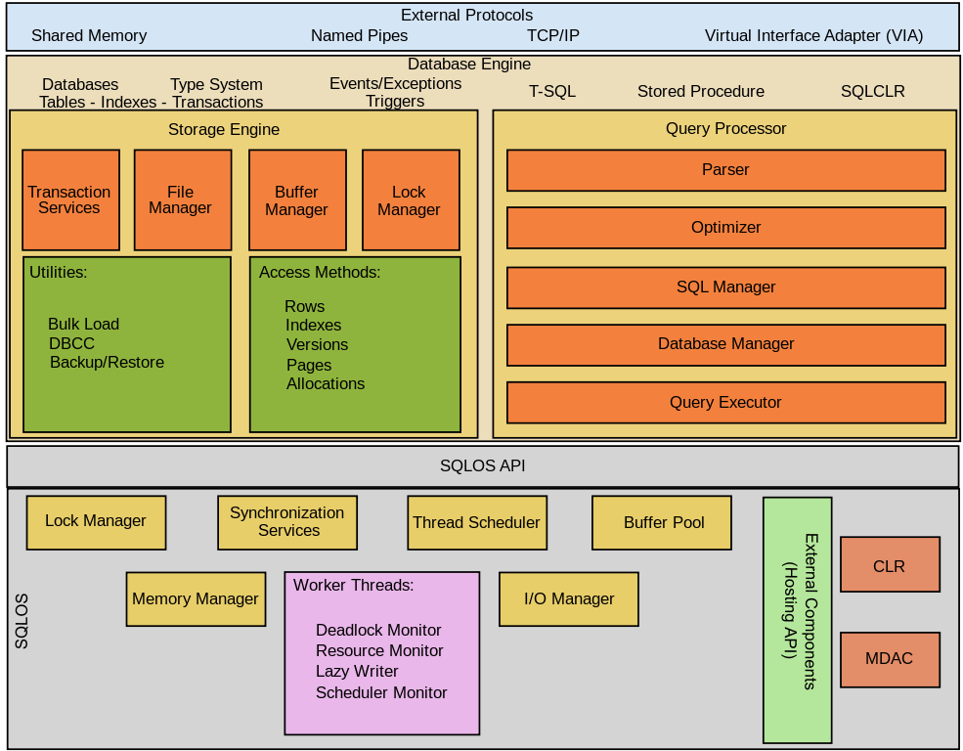
SQL Server Architecture

Slide 5
SQL Server Installation
https://www.microsoft.com/en-us/sql-server/sql-server-downloads

Slide 6
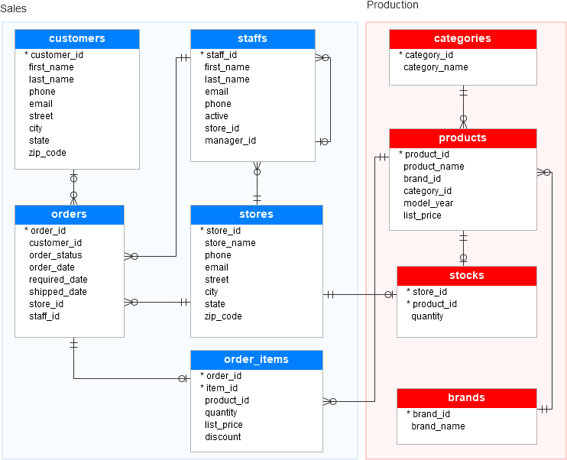
SQL Server Database

Slide 7
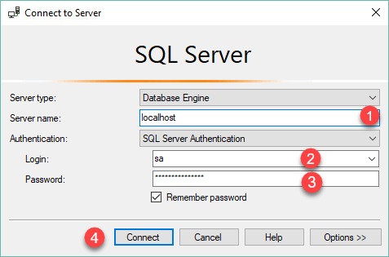
Load Database
https://www.sqlservertutorial.net/wp-content/uploads/SQL-Server-Sample-Database.zip
Step 1

Slide 8
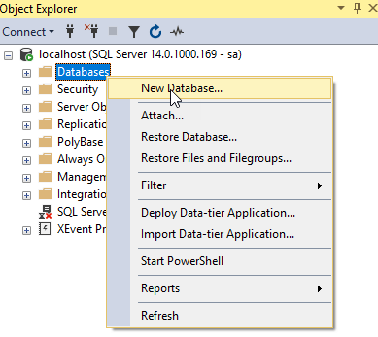
Load Database
Step 2

Slide 9
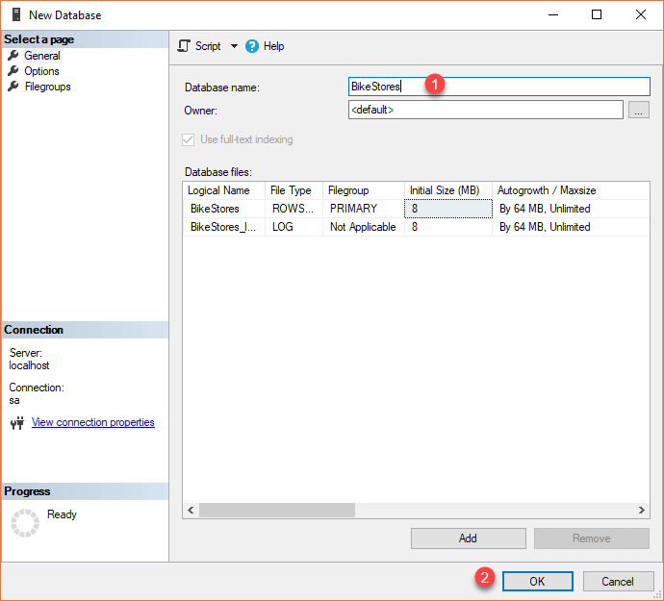
Load Database
Step 3

Slide 10
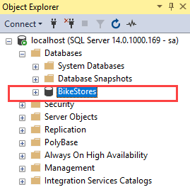
Load Database
Step 4

Slide 11
Load Database
Step 4

Slide 12
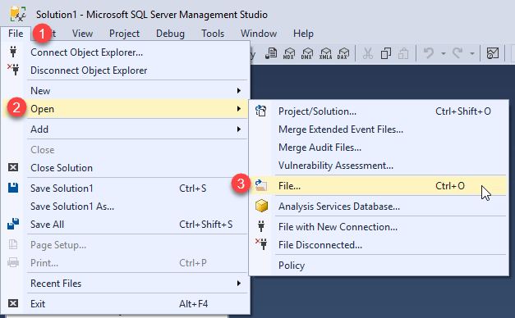
Load Database
Step 4

Slide 13
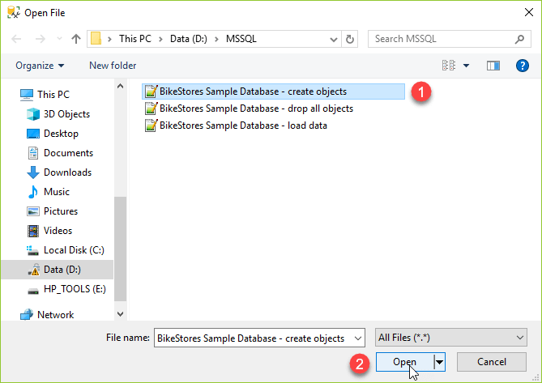
Load Database
Step 4

Slide 14
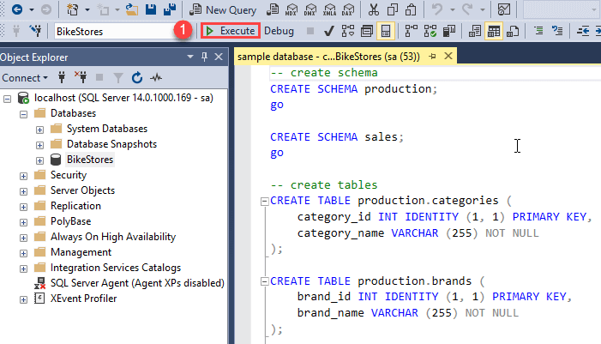
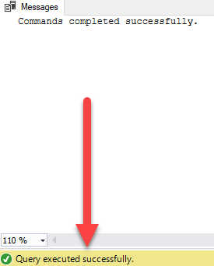
Load Database
Step 4

Slide 15
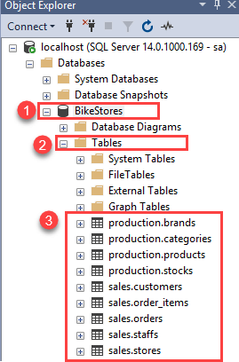
Load Database
Step 4

Slide 16



Slide 17
Querying Data

